Slide 2
Introduction
In this tutorial, we will explore the fundamental building block of digital circuits — the CMOS inverter. Though seemingly simple, its performance in terms of propagation delay and noise margin plays a crucial role in determining the reliability and speed of larger integrated circuits.
We’ll start by understanding how device sizing impacts inverter speed and robustness, and how we can use methods like the average current method to design circuits that meet real-world specifications.
Furthermore, we’ll discuss how noise margins (both low and high) define the inverter’s immunity to voltage fluctuations — a critical aspect in ensuring error-free logic operations in noisy environments.
By the end of this session, you’ll not only learn how to size transistors based on timing constraints but also intuitively grasp why these calculations matter and how they affect circuit behavior.

Slide 3
Analogies to Build Intuition
1. Water Pipe Analogy for Propagation Delay
  Think of the inverter as a water pipe system where current is like water flow and capacitance is like a bucket being filled or emptied.
  The inverter’s delay is similar to how fast you can fill or drain the bucket. Bigger pipes (transistors with larger width) allow more current to flow, filling or draining the load faster, hence reducing delay.
2. Gatekeeper Analogy for Noise Margin
  The inverter is like a gatekeeper deciding whether a signal is a ‘0’ or a ‘1’.
  A higher noise margin means the gatekeeper is stricter and less likely to be fooled by small disturbances (like wind pushing the gate slightly open).
  A lower noise margin means it’s easier for noise to cause misinterpretation.
3. Average Current Method Analogy
  Imagine trying to estimate how quickly water will fill a bucket by using the average rate at which water flows, rather than accounting for every instant separately. This simplifies calculations while giving a good approximation.

Slide 4
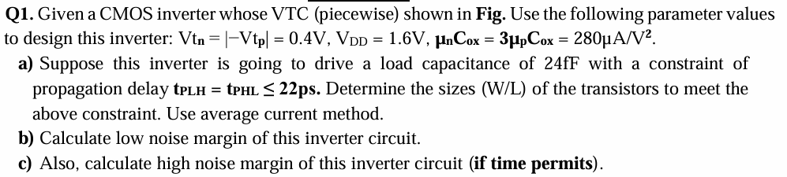

Slide 5
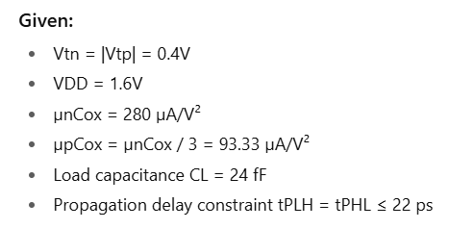

Slide 6
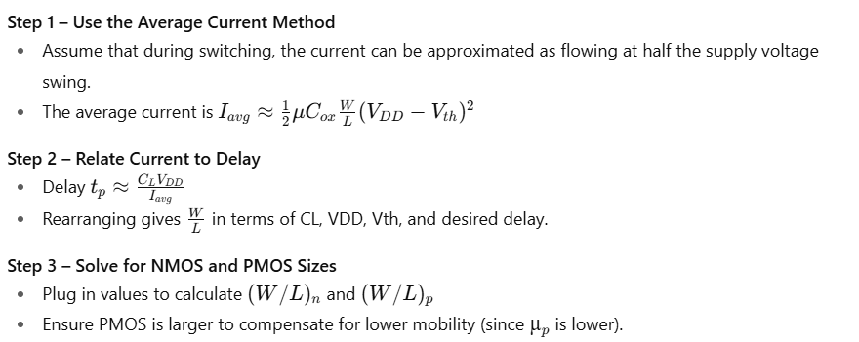
Q1a – Sizing the Transistors (W/L)

Slide 7
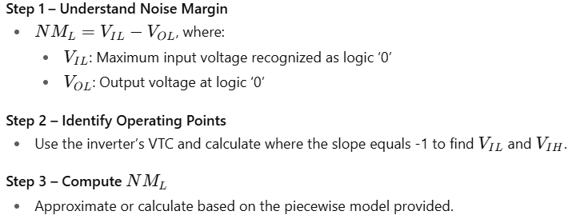
Q1b – Low Noise Margin Calculation

Slide 8

Q1c – High Noise Margin Calculation (Optional)

Slide 9
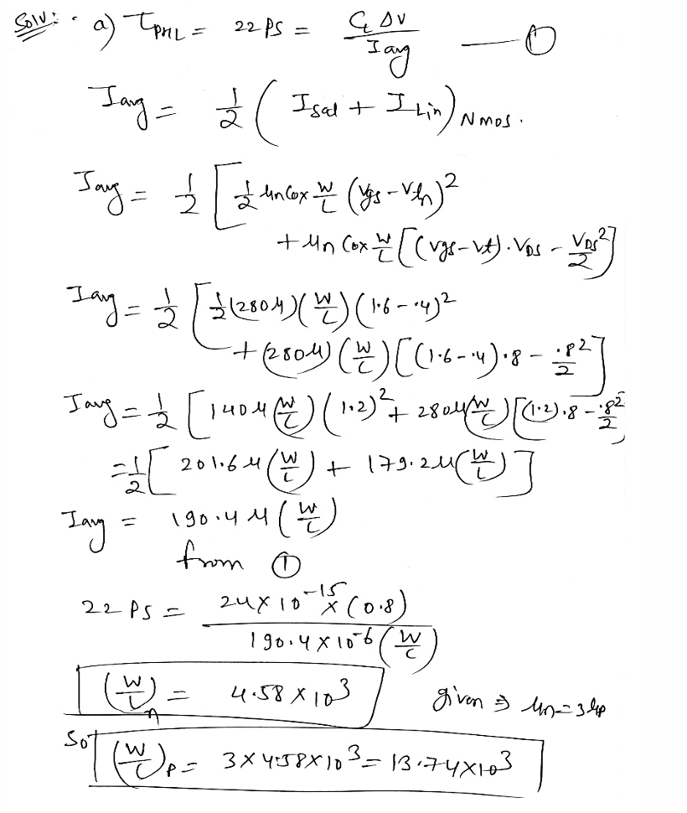

Slide 10
